Slide 1
Software Estimation
Notes:
SOFTWARE PROJECT ESTIMATING PRACTICAL UTILITY OF THIS PRESENTATION: Whether Business Planning, Software Development, Commercial Construction, or any of numerous other business endeavors, significant critical success factors for all projects hinge on effective Estimation. This presentation addresses two aspects of estimation:
1. Effective technical estimates of the time, skills, and resources required for project success
2. Plus effective use of Estimates to frame the risks of failure faced by the project team
BUSINESS PURPOSE:
1. This presentation provides an overview of current research, experience, and thinking about Software Project Estimating. These “Lessons Learned” are from the IT arena – I assert these lessons can be effectively generalized for direct use in other, non-Software Projects. This presentation focuses on PMI methods and current best practices. All these “Lessons Learned” are tool and methodology independent.
2. These “tool independent lessons” will be input for estimating within Microsoft’s Project – my “light weight” example will start with an example using the desktop version of Microsoft Project 2003.

Slide 2
Software Estimation:
Demystifying the Black Art
While there is a limit to how good a project can go, there is no limit to how poorly a project can go.
Notes:
PRESENTOR’S EDUCATION: After completing my Masters in Public Administration at Georgia State University in 1976, I started using business process flowcharting in such areas as public policy analysis and public-sector business process reengineering (BPR).
Presentor’s IT Project Management Experience: From 1991 my last 18 years focused on managing IT Strategic Planning Projects and IT Application Projects. These were projects, which automated business processes linked to Strategic Plans. Some of the IT Strategic Planning (ITSP) projects I managed included the ITSP’s for
1998 the first ITSP for the Georgia Department of Revenue,
2000 ITSP for the Georgia Department of Administrative Services, and
2001 the first ITSP for the Georgia Department of Transportation (DOT) – I retired from the State of Georgia on June 30, 2006, with over 34 years service
In February 2008, started as an IT Project Manager with CDC’s Office of Workforce and Career Development (OWCD), my contract is through CNI

Slide 3
Software Estimation:
Demystifying the Black Art
“The most unsuccessful three years in the education of Cost Estimators appears to be fifth-grade arithmetic.”
– Norman R. Augustine
Notes:
Norman Ralph Augustine (born July 27, 1935) is a U.S. aircraft businessman. Source: Wikipedia

Slide 4
Software Estimation:
Demystifying the Black Art
What is the Estimation Process?
Unstable Functionality Fixed
Experienced Staff Diverted to Trade Show
Staff Not Ready
Requirements Changed
Estimate → 20 Staff Months → Actual
Inexperienced Staff Added
Other Experienced Staff Diverted to Old System
More Requirements Added
Requirements Added
Notes:
Show of hands; does this Generic Project Fishbone Diagram look familiar?
If this is a flowchart of the Project Process, what is the flowchart of the Estimation Process?
Would it be correct (or kind) to say this project is dynamic?
Steve McConnell, Software Estimation: Demystifying the Black Art; p. 12, copyright 2006 Microsoft Press, Best Practices.

Slide 5
Software Estimation:
Demystifying the Black Art
What is a “Good Estimate?”
ESTIMATES ARE DYNAMIC: As shown in the flowchart, an estimated project is not the project which is ultimately delivered.
GOOD?: How much good will +/- 10% accuracy do, if the project’s underlying assumptions change by 100%?
Notes:
What are the limits on “Good?”
How Good is “Good Enough?”
What is an estimate?
From a Project Management point of view, how is Good Estimating tied to Good Version Control?

Slide 6
Software Estimation:
Demystifying the Black Art
It is very difficult to make a vigorous, plausible, and job-risking defense of an estimate that is derived by no quantitative method, supported by little data, and certified chiefly by the hunches of the managers.
Fred Brooks
SOURCE: Steve McConnell, Software Estimation: Demystifying the Black Art; p. 3, copyright 2006 Microsoft Press, Best Practices.
Notes:
Steve McConnell, Software Estimation: Demystifying the Black Art; p. 3, copyright 2006 Microsoft Press, Best Practices.
I believe this is the essence of a CMMI Level 0 organization – an entity with the bare minimum of SDLC best practices.

Slide 7
Software Estimation:
Demystifying the Black Art
Defining terms:
Target: Statement of a desirable Business Objective
Commitment: A promise to deliver defined functionality at a specific level of quality by a date certain. More aggressive than an estimate.
Project Control: Constraining expectations and adjusting schedules, resources, and delivered functionality in order to meet targets
Notes:
Target: McConnell, p. 3
Commitment: McConnell, p. 4
Project Control: McConnell, p. 11-14

Slide 8
Software Estimation:
Demystifying the Black Art
If an estimate is not a:
  Target
  Commitment
  Project Control
What is an estimate?
Notes:
Defining an estimate: Sometime and estimate is called a “guesstimate.” In other words, this is an informal way to indicate an estimate is an educated guess, giving a range of numbers likely to include the actual results.
Estimates usually involve inputs such as time, cost, skills and outputs such as performance, functionality and quality.

Slide 9
Software Estimation:
Demystifying the Black Art
“A Good Estimate is an estimate, which provides a clear enough view of the project reality to allow the project leadership to make good decisions about how to control the project to hit its targets.”
KEY FRAMEWORK: See Computerworld, January 12, 2009 p. 27 “The Covert PMO” by Thomas Cutting.
Notes:
Practical Politics of Estimation:
1. KEY TERMS: Define and stick to key concepts, terms, and principles; especially the distinction between estimates and other concepts, such as targets, commitments, and controls, which exist in the business and project environment.
2. KEY PRACTICES: First, avoid making these verbal mistakes, do not provide or state:
“rough estimates,”
“point estimates,”
“best guesses,”
any other form of “helping out”
“avoid all unrealistic ‘time boxes’ for completing estimation steps,” (This is methodology independent!)
Always remain committed to “adequate research,” “get back to you with analysis,” and provide “appropriate ranges,” never point estimates.
Remember Donald Rumsfeld’s caution concerning the, “. . . Unknown unknowns. . . .”
KEY FRAMEWORK: See Computerworld January 12, 2009 p. 27 “The Covert PMO” by Thomas Cutting.

Slide 10
Software Estimation:
Demystifying the Black Art
Characteristic of a “Good Estimate?”
An estimate stated as a probability is one sign of a “Good Estimate.”
TIP: When you see a point estimate ask if it is really an estimate or a target.
TIP: When you are asked to provide an estimate, determine if you are supposed to be estimating or really figuring out a way to hit a target.
Notes:
While there is a limit to how good a project can go, there is no limit to how poorly a project can go.
Later we will return to the characteristics of a “Good Estimate.”
All estimates include a probability, whether that probability is stated or implied. A sign of a “Good Estimate” is a clear probability statement.

Slide 11
Software Estimation:
Demystifying the Black Art
What are the Two types of Estimating?
1. Art of Estimating:
+/- 25% of Actual Time and Cost
2. Science of Estimating:
+/- 10% of Actual Time and Cost

Slide 12
Software Estimation:
Demystifying the Black Art
“… a good estimation approach should provide estimate that are within 25% of the actual results 75% of the time.” (Conte, Dunsmoren and Shen 1986)
This standard is the most common standard used to evaluate estimation accuracy (Stutzke 2005).
Notes:
This is parallel to the 80/20 rule of thumb used in several business areas:
Project Management – the final 20% of a project requires 80% of the resources
Mortgage Lending – a loan is fully secure, when the loan value is < 80% of the collateral’s market value

Slide 13
Software Estimation:
Demystifying the Black Art
“… [estimation] accuracy of +/- 10% is possible, but only on well controlled projects. Chaotic projects have too much variability to achieve that level of accuracy.” (Jones 1998)
Notes:
What is a “well controlled project?”
Published results from Boeing and from the U.S. Air Force show the predictability of projects improved dramatically as the organizations moved toward higher CMM (Capability Maturity Model) levels. CMM was initially developed at SEI – the Software Engineering Institute. SEI was founded in the "80's by Watts Humphrey at Carnegie Mellon University.
SEI's initial Business Purpose was to develop metrics for use by DOD (Dept. of Defense) in evaluating contract software quality and reliability.
In essence this model -- the CMM (Capability Maturity Model) -- is the practical application to Software Development of Statistical Process Control methods. CMM is a direct descendent of the Statistical Process Control methods Deming and Jurand developed for America’s WWII war industries and later applied for Japan's re-industrialization after WWII.
SOAPBOX These were the very methods, which Toyota used to kick GMC and Ford's butts on quality in the US market starting in the '70's. Recently a software quality institute in India was named in honor of Watts Humphrey. Where is the Atlanta Chapter of the Watts Humphery Institute?

Slide 14
Software Estimation:
Demystifying the Black Art
In other words, “It is better to be roughly right than precisely wrong.” (unknown)
Notes:
What are the limits on “Good?”
How Good is “Good Enough?”
What is an estimate?
From a Project Management point of view, how is Good Estimating tied to Good Version Control?

Slide 15
Software Estimation:
Demystifying the Black Art
“The process is called Estimation, not Exactimation.”
- Phillip Armour
If “Scientific Estimating” is +/- 10%, then how confident is “90% Confident?”
Notes:
Philip Danforth Armour (16 May 1832 – 6 January 1901) was an American businessman. Partner in forming Armour and Company in 1867, which soon became the world's largest food processing and chemical manufacturing enterprise . . . http://en.wikipedia.org/wiki/Philip_Danforth_Armour

Slide 16
Software Estimation:
Demystifying the Black Art
How Good an Estimator are you?
POP Quiz!
Notes:
HANDOUT 1: On the next screen are 10 questions. These questions appear in the handout, which you can score – honor system ☺ – and keep.
I will read these ten questions for our web audience.
I gave this test to my neighbor who is a retired Mechanical Engineer, with 40 years experience as a plant manager in England, Canada, and the U. S.
His “rule of thumb” for capital projects is there is more forgiveness for over-estimating the time and slightly over-spending the project budget, when:
The project is successfully completed ahead of schedule
Thus the project is generating revenue or cash-flow ahead of schedule
He felt this rule of thumb would be applicable in many different industries, such as web-based e-business
For example:
Estimated 7 Months and $1.1 Million budgeted
Actual 6 Months and $1.2 Million spent – but delivering positive cash-flow ahead of schedule

Slide 17
Low | High | Description
 |  | 1. Surface Temperature of the Sun?
 |  | 2. Latitude of Shanghais?
 |  | 3. Area of the Asian Continent?
 |  | 4. The Year of Alexander the Great’s birth?
 |  | 5. Total value of U. S. Currency in circulation in 2004?
 |  | 6. Total Volume of the Great Lakes?
 |  | 7. Worldwide box office receipts for the Movie Titanic?
 |  | 8. Total length of the coastline of the Pacific Ocean?
 |  | 9. Number of book titles published in the U. S. since 1776 to 2006?
 |  | 10. Heaviest blue whale ever recorded?
Notes:
PURPOSES OF POP TEST:
If we need 90% confidence – that is +/- 10% for scientific estimating. Then, what is 90% Confidence?
Have some fun.
TIMING: You will have about 5 minutes, while I read each of these questions.
INSTRUCTIONS: Fill in the lower and upper estimates, which in your opinion gives you a 90% chance of including the correct answer.
SCORING: Scoring is on the honor system. When I read the answers, give yourself one point for each range you noted which contains the correct answer.

Slide 18
Software Estimation:
Demystifying the Black Art
From a probability standpoint, you have a 93% chance of answering 8 questions correctly
Steve McConnell has given this test to numerous groups
No one has ever gotten 10 correct
Only 2% have gotten 8 correct
Conclusion, “people’s intuitive sense of ’90% confident’ . . . [is closer to] . . . ’30% confident.’” (p. 17)
Notes:
HANDOUT 2:

Slide 19
Software Estimation:
Demystifying the Black Art
Accurate estimation results cannot be accomplished through estimation practices alone.
Accurate estimation must be supported by effective project control.
Accurate estimation exists inside a larger business culture
Notes:
McConnell p. 11

Slide 20
Software Estimation:
Demystifying the Black Art
Estimation accuracy and the dangers of under-estimating
While there is a limit to how good a project can go, there is no limit to how poorly a project can go.
Notes:
“…the penalty for overestimation is linear and bounded – work will expand to fill available time, but it will expand no further.”
“. . . The penalty for underestimation is nonlinear and unbounded – planning for errors, shortchanging upstream activities, and the creation of more defect cause more damage than overestimation does, and with little ability to predict the extent of the damage ahead of time. . . .”
McConnell, p. 24

Slide 21
Software Estimation:
Demystifying the Black Art
“ . . .We often speak of the software industry’s estimation problem as though it were a neutral estimation problem . . .
“. . . But the software [industry] does not have a neutral estimation problem. The industry data shows clearly that the software industry has an underestimation problem. . . .” (McConnell, p. 27)

Slide 22
Software Estimation:
Demystifying the Black Art
TIP: Don’t reduce developer estimates, they are probably too optimistic already.
TIP: Don’t give off-the-cuff estimates. Even a 15-minute estimate will be more accurate.

Slide 23
Breadcrumbs:
  Open New Project
  Split Screen
  Add New Task
  In Split Screen select Fixed Work
  Add (estimated) Work
  Add resource
  Add or “Post” Actual Work

Slide 24
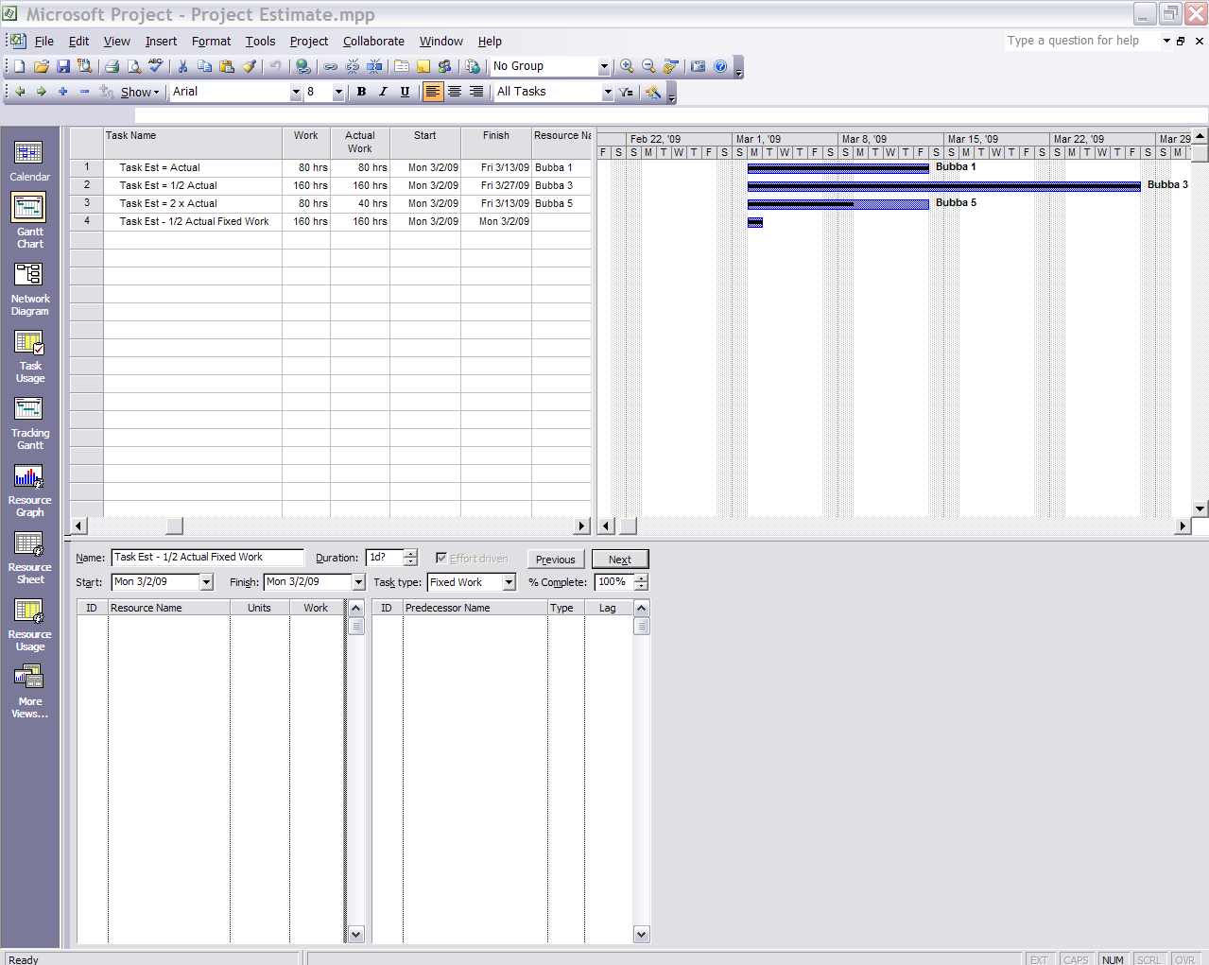
Project 2003 – autocalculation.

Slide 25
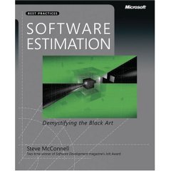
Software Estimation:
Demystifying the Black Art
Notes:
Steve McConnell, Software Estimation: Demystifying the Black Art; copyright 2006 Microsoft Press, Best Practices.
A major reference source for tonight’s presentation is Steve McConnell’s book – I would recommend each practicing Project Manager own and use a copy.

